Slide 1
LINEAR PROGRAMMING
SIMPLEX METHOD

Slide 2
Outline
Introduction
  Terminology
  Solving LP Problems
Problem Statement
  Algebric Formulation
  Graphical Formulation
Simplex Method

Slide 3
Introduction
A Linear Programming problem is a special case of a Mathematical Programming problem.
Linear programming involves identifying an extreme (i.e., minimum or maximum) point of a function f(x1, x2, ..., xn), which furthermore satisfies a set of constraints, g(x1, x2,...xn)≤ bi.
Linear programming is widely used in industry, governmental organizations, ecological sciences, transportation and business organizations to minimize objectives functions, which can be production costs, numbers of employees to hire, or quantity of pollutants released, given a set of constraints such as availability of workers, of machines, or labors time.

Slide 4
General Form Of LP Problems
MAX (or MIN): c₁X₁ + c₂X₂ + … + c_{n}X_{n}
Subject to: a11*x1+ a12*x2+…..+ a1n*xn ≤ b1 a21*x1+ a22*x2+..…+ a2n*xn ≤ b2 am1*x1+ am2*x2+..…+ amn*xn ≤ bm,
and
x1≥ 0, x2 ≥ 0, ....., xn ≥ 0.

Slide 5
Type of LP Problems
There are five common types of decisions in which LP may play a role
  Product mix
  Ingredient mix
  Transportation
  Production plan
  Assignment

Slide 6
Terminology
Objective Function:
An output function that you want to maximize or minimize.
  E.g. Maximize profit, yield, contribution
  E.g. Minimize cost, space used, time taken, or risk
Decision Variables:
A set of input variables whose values you can change.
  E.g. The number of units of a product we should produce.
  E.g. The number of items to store in a warehouse.
  E.g. The amount of material we should buy.
Constraints:
A set of restrictions on the permissible values (or combinations of values) of the input variables.
  E.g. Cannot produce less than 0 units of a product.
  E.g. Cannot use more than 1,000 yards of material.

Slide 7
Terminology for Solutions
Feasible solution: A solution for which all the constraints are satisfied. It is possible for a problem to have no feasible solutions. Given that there are feasible solutions, the goal of the linear programming is to find which one is the best, as measured by the value of the objective function in the model.
Optimal solution: A feasible solution that has the most favorable value of the objective function. Most favorable value means the largest or the smallest value, depending upon whether the objective is maximization or minimization.
        one optimal solution
        multiple optimal solutions
        no optimal solutions

Slide 8
Solving LP Problems
Graphical Solution Approach - used mainly as a teaching tool.
Simplex Method - most common analytic tool.
Transportation Method - one of the earliest methods.
Assignment Method - occasionally used in OM (Operations Management).

Slide 9
Steps in Formulating a
Linear Programming (LP) Model
Understand the problem.
Identify the decision variables.
State the objective function as a linear combination of the decision variables.
State the constraints:
    upper or lower bounds on the decision variables, including non-negativity constraints if applicable.
    linear combinations of the decision variables.

Slide 10

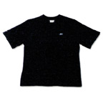
Problem Statement
Sleeveless and Sleeve Example
Reebok Sports manufactures two types of t-shirts: sleeveless with logo and sleeve.
How many sleevelesses and how many slevees should be produced per week, to maximize profits, given the following constraints…
  The (profit) contribution per sleeveless is $3.00, compared to $4.50 per sleeve.
  Sleeve use 0.5 yards of material; sleeveless use 0.4 yards. 300 yards of material are available.
  It requires 1 hour to manufacture one sleeveless and 2 hours for one sleevee. 900 labors hours are available.
  There is unlimited demand for sleeveless but total demand for sleeve is 375 units per week.
  Each sleeveless uses 1 insignia logo and 600 insignia logos are in stock.

Slide 11
Algebraic Formulation

Slide 12
The Algebraic LP Formulation
Variables: number of Sleevelesses, number of Sleeves
Objective function:
  maximize ( $3.00 x Sleeveless ) + ( $4.50 x Sleeve )
Constraints:
  Material: ( 0.4 x Sleeveless ) + ( 0.5 x Sleeve ) <= 300 yards
  Labor: ( 1 x Sleeveless ) + ( 2 x Sleeve ) <= 900 hrs
  Demand: ( 0 x Sleeveless ) + ( 1 x Sleeve ) <= 375 units
  Logos: ( 1 x Sleeveless ) + ( 0 x Sleeve ) <= 600
  Non-Negativity:
  Sleeveless >= 0
  Sleeve >= 0

Slide 13
Graphical Formulation

Slide 14
The Graphical LP Formulation
Material Constraint
The Equation of a Line
900
0.4× Sleeveless + 0.5× Sleeve = 300 Yards
800
750
It is useful when the problem have two variables.
700
600
Sleeveless
500
Place your Decision Variables on the axes of the graph.
  x = Sleeve
  y = Sleeveless
  So, the line is:
  0.4y + 0.5x = 300
400
300
200
Material
100
100
200
300
400
500
600
700
800
Sleeve

Slide 15

The Graphical LP Formulation
Material Constraint
The Area Under a Line
900
0.4× Sleeveless + 0.5× Sleeve = 300 Yards
800
0.4× Sleeveless + 0.5× Sleeve ≤ 300 yards happens to be an upper bound constraint.
To determine which side of the line to shade, substitute the point (0,0) into the equation:
0.4(0) + 0.5(0) ≤ 300
Since the inequality holds, (0,0) must be within the feasible region, so shade the side of the line where (0,0) lies.
700
600
Sleeveless
500
400
300
200
Material
100
(0,0)
100
200
300
400
500
600
700
800
900
Sleeve

Slide 16
The Graphical LP Formulation
Labor Constraint
900
Labor
( 1 × Sleeveless ) + ( 2 × Sleeve) = 900 Hours
800
700
600
Sleeveless
500
400
300
200
Material
100
100
200
300
400
500
600
700
800
900
Sleeve

Slide 17
The Graphical LP Formulation
Demand Constraint
900
Hours
800
( 0 × Sleeveless ) + ( 1 × Sleeve ) = 375
700
600
Sleeveless
Demand
500
400
300
200
Material
100
100
200
300
400
500
600
700
800
900
Sleeve

Slide 18
The Graphical LP Formulation
Logos Constraint
900
Hours
( 1 × Sleeveless ) + ( 0 × Sleeve ) <= 600 logos
800
700
Logos
600
Sleeveless
Demand
500
400
300
200
Material
100
100
200
300
400
500
600
700
800
900
Sleeve

Slide 19

The Graphical LP Formulation
Feasible Region
900
Hours
800
700
Logos
600
Sleeveless
Demand
500
400
300
200
Material
Feasible Region
100
100
200
300
400
500
600
700
800
900
Sleeve

Slide 20
The Graphical LP Formulation
Objective Function – Isoprofit Lines
900
Hours
800
700
Logos
600
Sleeveless
Demand
500
400
300
200
$600
100
Material
100
200
300
400
500
600
700
800
900
Sleeve
  ( $3 × Sleeveless ) + ( $4.5 × Sleeve ) = $600

Slide 21
The Graphical LP Formulation
Objective Function – Isoprofit Lines
900
Hours
800
700
Logos
600
Sleeveless
Demand
500
400
300
$1200
200
100
Material
100
200
300
400
500
600
700
800
900
Sleeve
( $3 × Sleeveless ) + ( $4.5 × Sleeve) = $1200

Slide 22
The Graphical LP Formulation
Objective Function – Isoprofit Lines
900
Hours
800
700
Logos
600
Sleeveless
Demand
500
400
$1800
300
200
100
Material
100
200
300
400
500
600
700
800
900
Sleeve
( $3 × Sleeveless ) + ( $4.5 × Sleeve ) = $1800

Slide 23
The Graphical LP Formulation
Optimal Solution
Notice that looking for the optimal solution
is a form of search process.
900
Hours
800
700
Logos
600
Sleeveless
Demand
500
D
Isoprofit line tangent to point D.
$3.00 × Sleeveless + $4.50 × Sleeve = $2400
400
300
200
100
Material
100
200
300
400
500
600
700
800
900
Sleeve

Slide 24
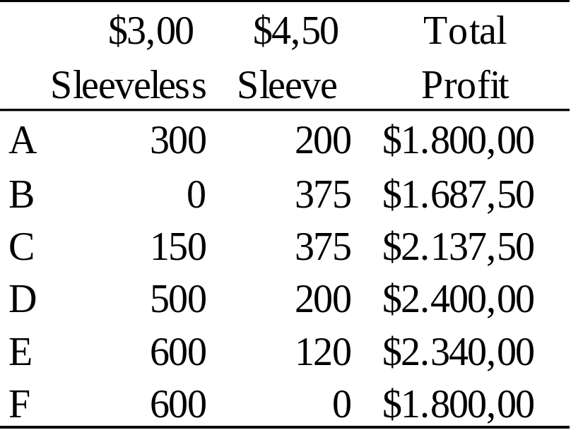

The Graphical LP Formulation
Optimal Solution
900
Hours
800
700
Logos
600
F
E
Demand
Sleeveless
500
D
Optimum
400
300
A
200
C
Material
100
B
100
200
300
400
500
600
700
800
900
Sleeve

Slide 25

Maximization vs Minimization
The position of your optimal point differs, depending upon
whether the objective is maximization or minimization.
Maximization
Minimization
Optimum (Max)
Isoprofit line
Y
Y
Isocost line
Optimum
(Min)
X
X

Slide 26
Fundemental Theorem Of LP
If the optimal value of the objective function in a linear programming problem exists, then that value must occur at one (or more) of the corner points of the feasible region.

Slide 27
Existence of Solution
(A) If the feasible region for a linear programming problem is bounded, then both the maximum value and the minimum value of the objective function always exist.
(B) If the feasible region is unbounded, and the coefficients of the objective function are positive, then the minimum value of the objective function exists, but the maximum value does not.
(C) If the feasible region is empty (that is, there are no points that satisfy all the constraints), the both the maximum value and the minimum value of the objective function do not exist.

Slide 28
Simplex
Method

Slide 29
Real LP Problems
Real-world LP problems often involve:
Hundreds or thousands of constraints
Large quantities of data
Many products and/or services
Many time periods
Numerous decision alternatives
… and other complications

Slide 30
Simplex Method
The simplex algorithm, which was discovered in1947 by George Dantzig, is a simple, straightforward method for solving linear programming problems.
It has proved to be remarkably efficient method that is used to solve huge problems on today’s computers.
Simplex method starts with a feasible solution and tests whether or not it is optimum. If not, the method proceeds a better solution.
In an algebric procedure, it is much more convenient to deal with equations than with inequality relationships. Therefore, the first step in the setting up the simplex method is to convert inequality constraints into equality constraints. This conversion can be succeeded by introducing slack variables.

Slide 31
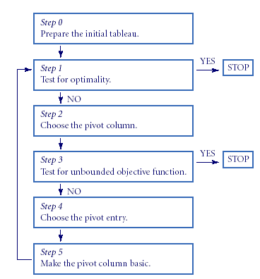
The Simplex Algorithm
All coefficients in the first row are positive
Objective Function has no maximum.

Slide 32
Table Formulation

Slide 33
LP Formulation
Maximize Z=3x₁+4.5x₂ Objective Function
where x₁=sleeveless, x₂=sleeve
0.4 x₁+0.5x₂≤300 Material
x₁+2x₂≤900 Labor
x₂≤375 Demand
x₁≤600 Logo
x₁≥0, x₂≥0 Nonnegativity
Constraints

Slide 34
LP Formulation 2
Converting inequality constraints into equality constraints by defining slack variables.
0.4 x₁+0.5x₂+x₃ =300 Material
x₁+2x₂+x₄ =900 Labor
x₂+x₅ =375 Demand
x₁+x₆ =600 Logo
The objective function can be defined as;
Z-3x₁-4.5x₂-0x₃-0x₄-0x₅-0x₆=0
instead of
Z=3x₁+4.5x₂

Slide 35
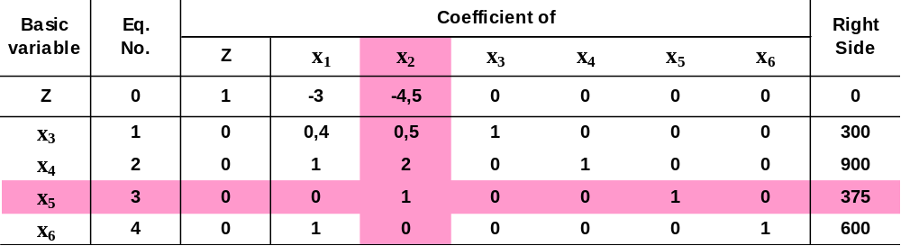
1. Iteration
300/0.5=600
900/2=450
375/1=375
Pivot column
Pivot row
Step Determine the entering basic variable. Having the largest absolute value in Eq. 0
Step Determine the leaving basic variable;
a) Picking out each coefficient in the column that is strictly positive,
b) Dividing each of them into “right side” for the same row,
c) Identifying the the equation that has the smallest ratio.
Row 0 [ -3 -4.5 0 0 0 0 : 0]
-(-4.5) [ 0 1 0 0 1 0 : 375]
---------------------------------------------------------- GAUSSIAN ELIMINATION
New Row [ -3 0 0 0 4.5 0 : 1687.5]

Slide 36
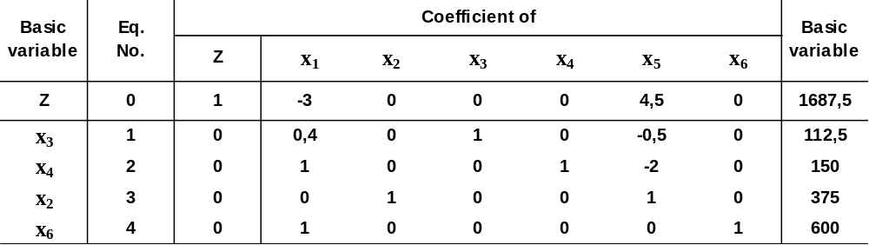
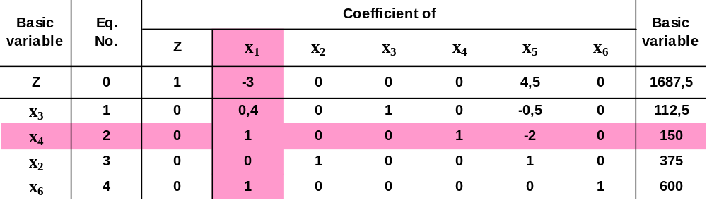
2. Iteration
x5
x2

Slide 37

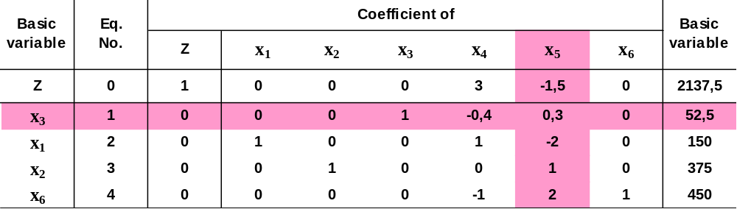
3. Iteration
x4
x1

Slide 38
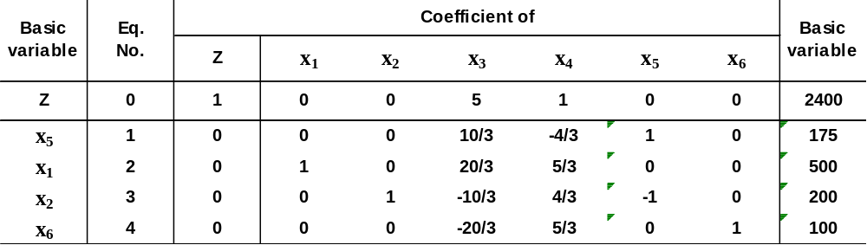
Optimal Solution
Depending on the optimality test, we found that solution is optimal because
none of the coefficients in Eq. 0 are negative, so the algorithm is finished.
Maximum Profit is $2400 when x₁=500 and x₂=200.
Reebok Sports must produce 500 sleeveless and 200 slevees per week to maximize the profit. At this condition the profit will be $2400....!

Slide 39
Thank you......

